Slide 1
POCUS project updates
Yiling Yang
Xiaoyang Li
12/04/2020

Slide 2
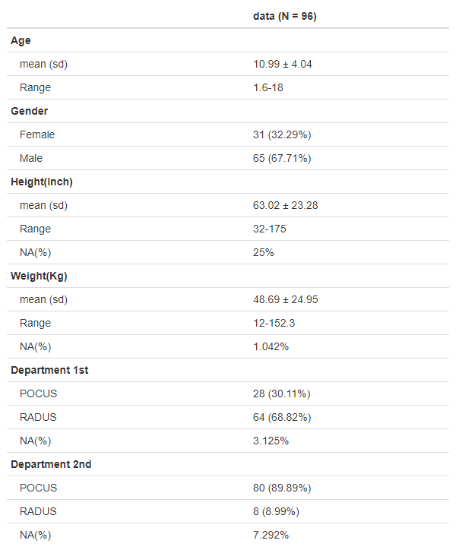
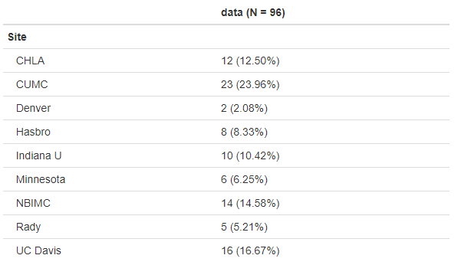
Descriptive Statistics of the subjects

Slide 3
4 x 4 confusion matrix between US 2 results and surgery findings
US2 | Surgery
Frequency | 1 | 2 | 3 | 4 | Total
1 | 11 | 0 | 0 | 0 | 11
2 | 21 | 7 | 0 | 0 | 28
3 | 12 | 6 | 4 | 9 | 31
4 | 2 | 1 | 0 | 2 | 5
Total | 46 | 14 | 4 | 11 | 75

Slide 4
2 x 2 confusion matrix between US 2 results and surgery findings
US 2 | Surgery
Frequency | 0 | 1 | Total
0 | 39 | 0 | 39
1 | 21 | 15 | 36
Total | 60 | 15 | 75
Sensitivity | 0.6500
Specificity | 1.0000
Positive Predictive Value | 1.0000
Negative Predictive Value | 0.4167

Slide 5
4 x 4 confusion matrix between US 1 results and surgery findings
US1 | Surgery
Frequency | 1 | 2 | 3 | 4 | Total
1 | 13 | 2 | 1 | 0 | 16
2 | 22 | 6 | 0 | 4 | 32
3 | 9 | 5 | 4 | 6 | 24
4 | 1 | 0 | 0 | 1 | 2
Total | 45 | 13 | 5 | 11 | 74

Slide 6
2 x 2 confusion matrix between US 1 results and surgery findings
US 1 | Surgery
Frequency | 0 | 1 | Total
0 | 43 | 5 | 48
1 | 15 | 11 | 26
Total | 58 | 16 | 74
Sensitivity | 0.7414
Specificity | 0.6875
Positive Predictive Value | 0.8958
Negative Predictive Value | 0.4231

Slide 7
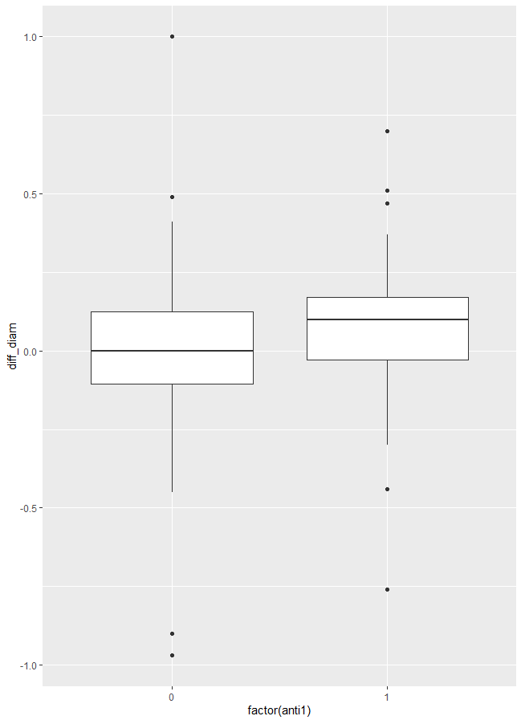
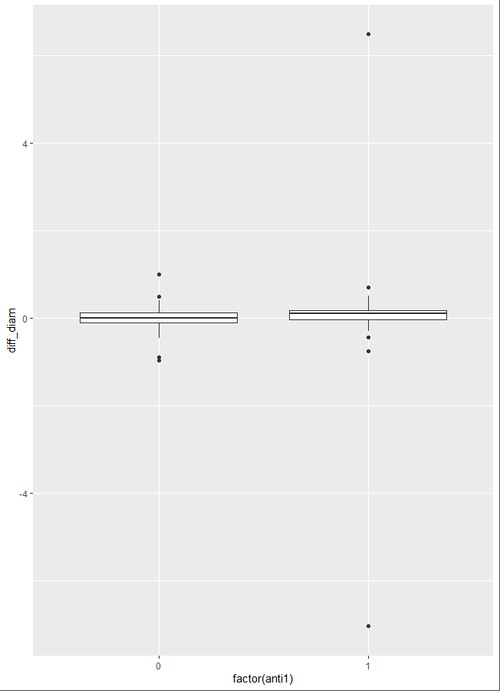
1st Antibiotic effect – t-test on appendix diameter
No received antibiotic | Received antibiotic | Total
40 | 43 | 83
T-test (include the outlier)
p.value | 0.808
Mean of anti = 0 | -3.350e-03
Mean of anti = 1 | 5.340e-02
T-test (remove the outlier)
p.value | 0.816
Mean of POCUS | 5.285e-02
Mean of RADUS | 13.086

Slide 8
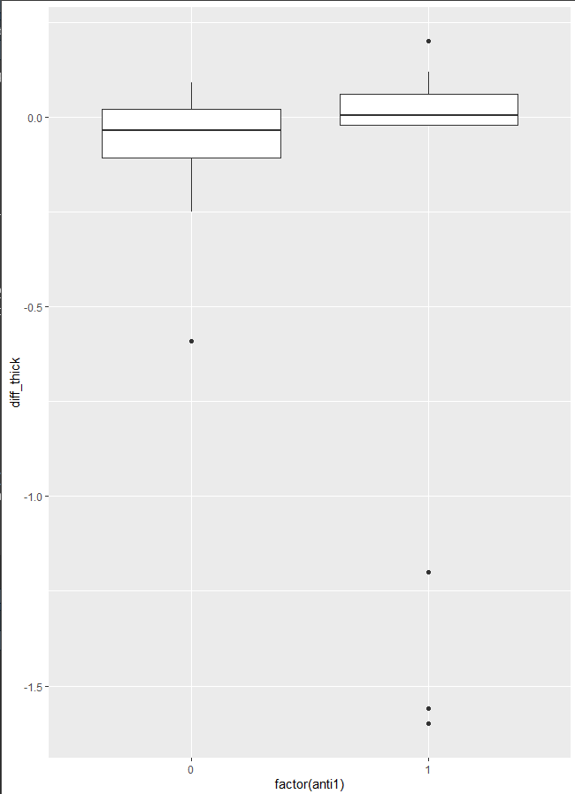
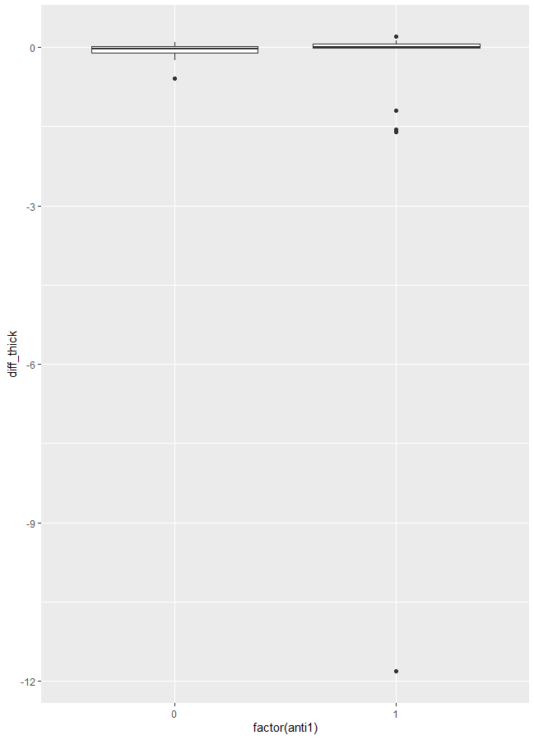
1st Antibiotic effect – t-test on mural thickness
No received antibiotic | Received antibiotic | Total
26 | 25 | 51
T-test (include the outlier)
p.value | 0.215
Mean of anti = 0 | -0.057
Mean of anti = 1 | -0.666
T-test (remove the outlier)
p.value | 0.225
Mean of POCUS | -0.057
Mean of RADUS | -0.200

Slide 9
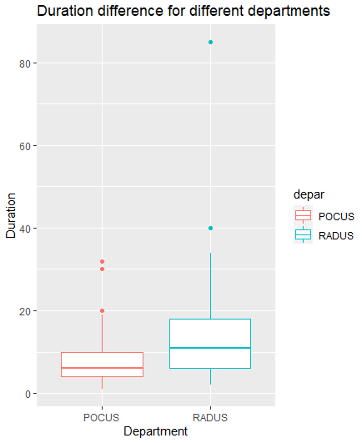
Duration difference between department
Remove duration = 0
T-test (include the outlier)
p.value | 2.119e-04
Mean of POCUS | 7.363
Mean of RADUS | 14.305
T-test (remove the outlier)
p.value | 3.726e-05
Mean of POCUS | 7.363
Mean of RADUS | 13.086

Slide 10
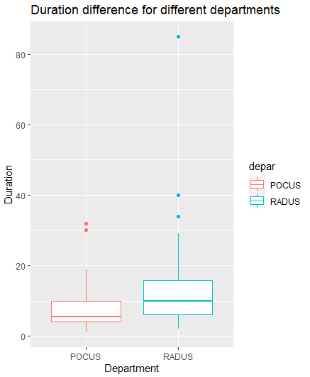
Duration difference between department for the same subject(46)
Remove duration = 0
T-test (include the outlier)
p.value | 0.01347
Mean of POCUS | 7.891
Mean of RADUS | 13.609
T-test (remove the outlier)
p.value | 0.01589
Mean of POCUS | 8.022
Mean of RADUS | 12.022

Slide 11
Prediction by scan characteristics
Response: Surgical report 0/1 (combine 1&2, 3&4)
Covariate from 2nd Ultrasound scan:
1) lossSM: loss of normal echogenic submucosal layer. In the dataset, loss of SM layer is captured by the ultrasound stage (combine 1&2, 3&4)
2) Muralthick: Maximum mural thickness
3) periappendiceal fluid: Presence of surrounding free fluid
4) fecalith: presence of fecalith
5) Appdiam: largest diameter of appendix
61 observations after remove NA

Slide 12
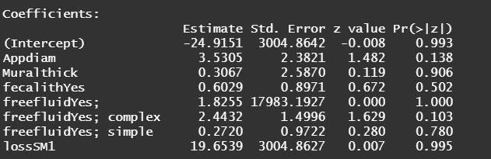
Prediction by scan characteristics – logistic regreesion
Freefluid
Original | No | Yes | Yes; simple | Yes; complex
FreefluidNew | 0 | 1 | 1 | 1
FreefluidCom | 0 | 0 | 0 | 1

Slide 13
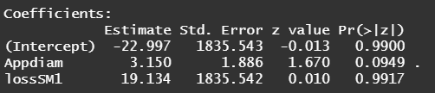
Prediction by scan characteristics – logistic regreesion
When using FreefluidNew:
prediction | Surgery
Frequency | 0 | 1 | Total
0 | 44 | 5 | 49
1 | 4 | 8 | 12
Total | 48 | 13 | 61
kappa | 0.547
Sensitivity | 0.615
Specificity | 0.916
Positive Predictive Value | 0.667
Negative Predictive Value | 0.898

Slide 14
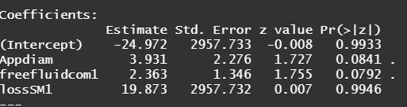
Prediction by scan characteristics – logistic regreesion
When using FreefluidCom:
prediction | Surgery
Frequency | 0 | 1 | Total
0 | 45 | 7 | 52
1 | 3 | 6 | 9
Total | 48 | 13 | 61
kappa | 0.450
Sensitivity | 0.462
Specificity | 0.937
Positive Predictive Value | 0.667
Negative Predictive Value | 0.865

Slide 15
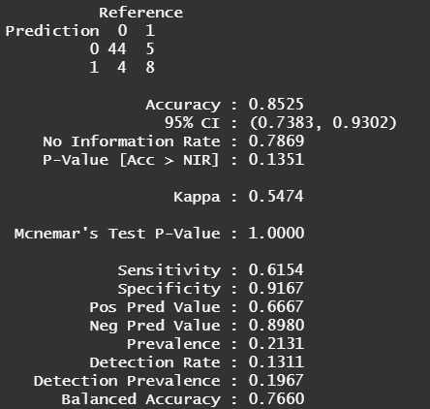
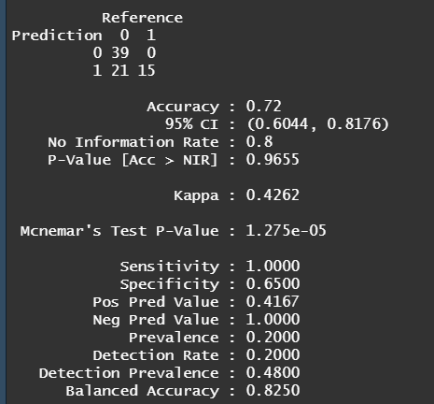
Predict surgical outcome by Logistic Model based on scan characteristics
Predict surgical outcome by 2nd US results

Slide 16
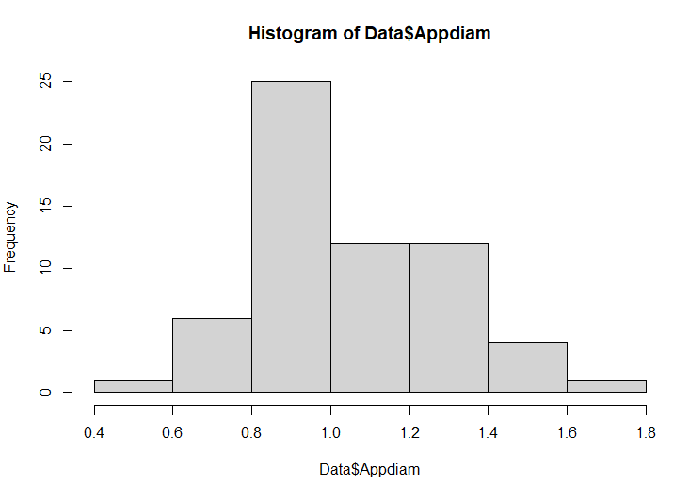
ROC curves of surgical result prediction
Set the grid of cutoff at
0.8 0.9 1.0 1.1 1.2 1.3 1.4
Turn appdiam as binary vatiable
surg_bi ~ Appdiam + lossSM

Slide 17
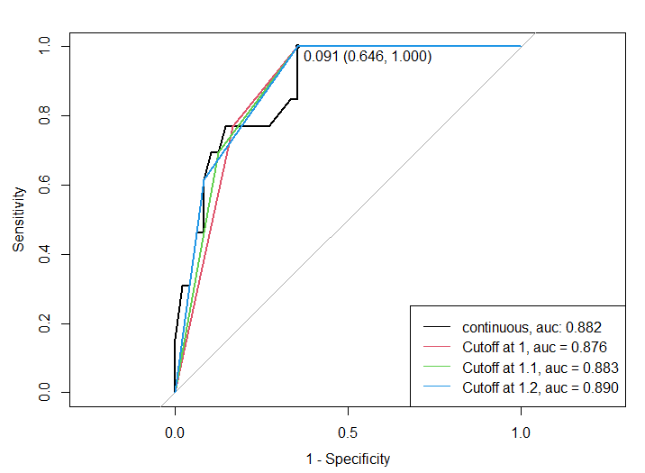




ROC curves of surgical result prediction
Calculate the corresponding prediction probability and cut probability at 0.5 to get below table
appDiam | continuous | Cut at 1mm | Cut at 1.1mm | Cut at 1.2mm
Accuracy | 0.853 | 0.820 | 0.836 | 0.853
Kappa | 0.547 | 0.529 | 0.537 | 0.547
Sensitivity | 0.615 | 0.769 | 0.692 | 0.615
Specificity | 0.917 | 0.833 | 0.875 | 0.917
AUC | 0.882 | 0.876 | 0.883 | 0.890

Slide 18
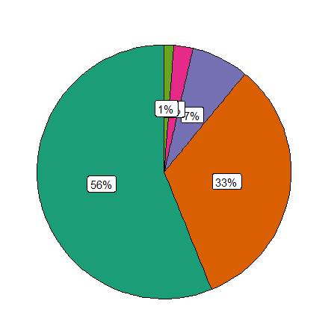
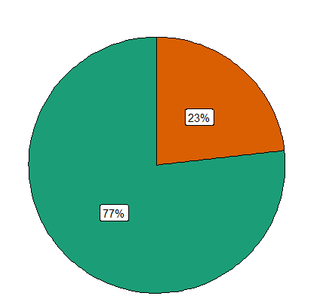
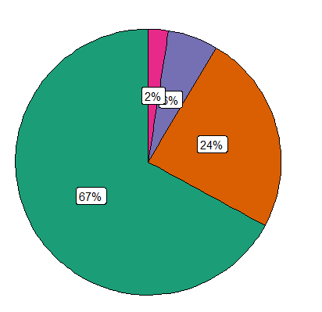
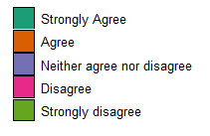
Receptivity
Perform
Tolerated
Accepted
The Ultrasound was technically easy to perform
The Ultrasound was well tolerated by the patient
The Ultrasound was well-accepted by the family

